Slide 1

Object Detection Using Vision Transformers
Department of Electronic Engineering
Project Work
Submitted by
Abdul-Azeez Olanlokun
Mat.Nr.: 2180593
Supervised by
Prof. Stefan Henkler
December 2023

Slide 2
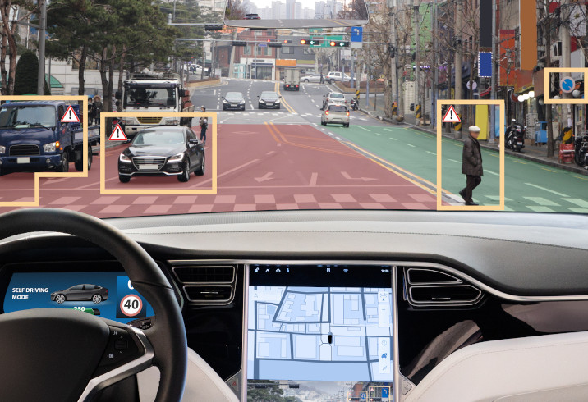
Motivation
Challenges
Why Object Detectetion
Challenges in Object Detection
Need for Advanced Techniques
[1]

Slide 3
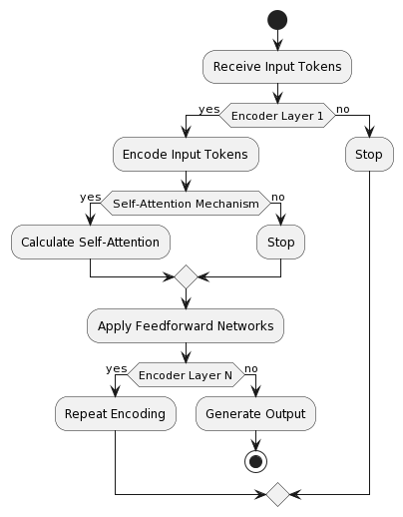
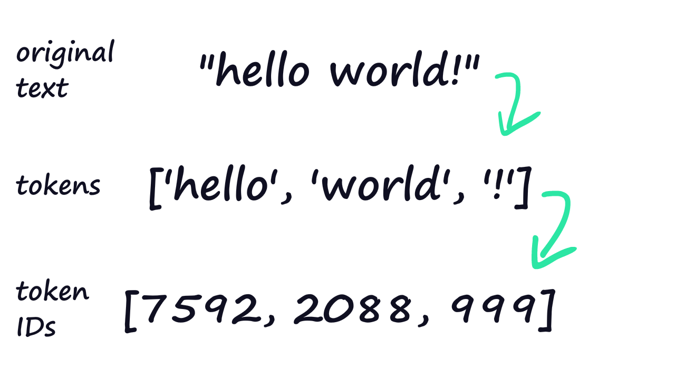
Brief Introduction to Transformers
Transformer Tokinizer [2]
An Activity Diagram of the Original Transformer according to [4]

Slide 4
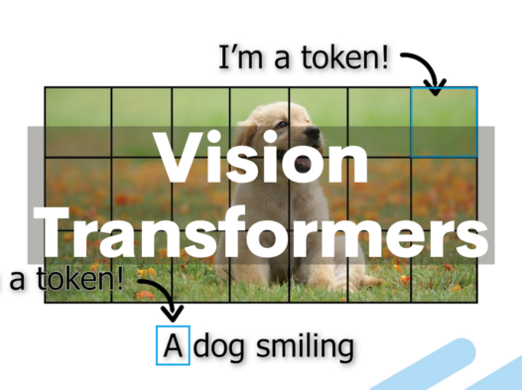
Introduction to Vision Transformers (ViTs)
Definition
Significance in Computer Vision
[3]

Slide 5
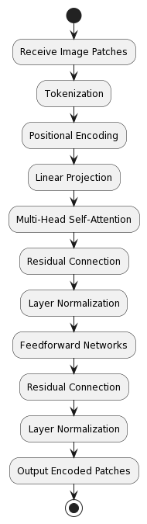
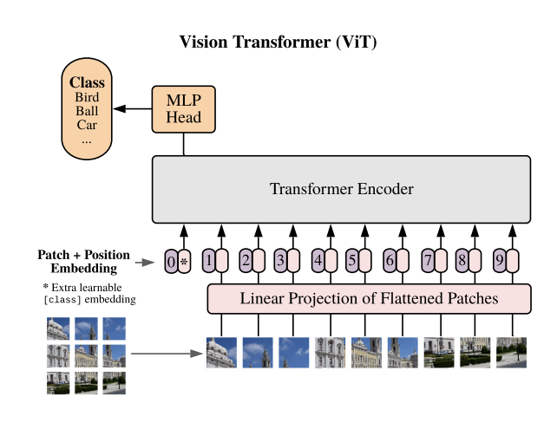
Vision Transformer Architecture
Vision Transformer Architecture [4]
Activity Diagram for the ViT process according to[4]

Slide 6
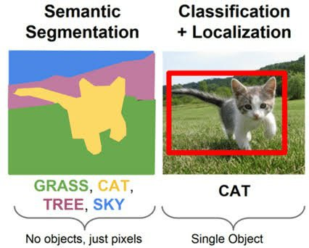
Other Applications of Vision Transformers
image classification
segmentation, and other computer vision tasks.
[5]

Slide 7
Pros & Cons of Vision Transformers
Pros
Global Context Understanding
Scalability
Adaptability to Varying Resolutions
Cons
Computational Intensity and Efficiency
Scalability to Large Datasets
Large-Scale Annotation Requirements

Slide 8
Use Case - DETR Model
Overview
DEtection TRansformer (DETR) model as a specific use case of Vision Transformers in object detection.
An end-to-end object detection Approach

Slide 9
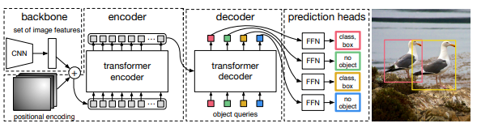
Use Case - DETR Architecture
DETR Architecture [6]

Slide 10
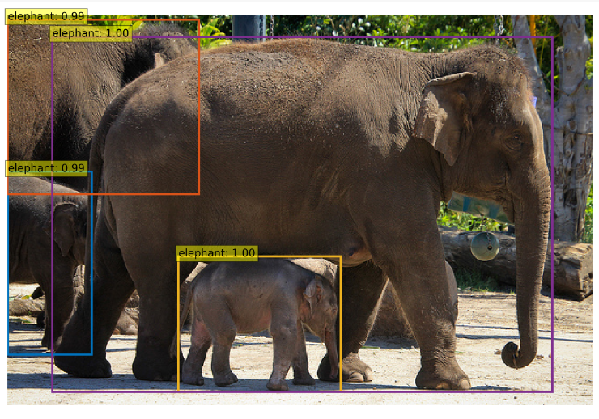
Evaluation
Datasets
Detected Objects with DETR model implementation

Slide 11
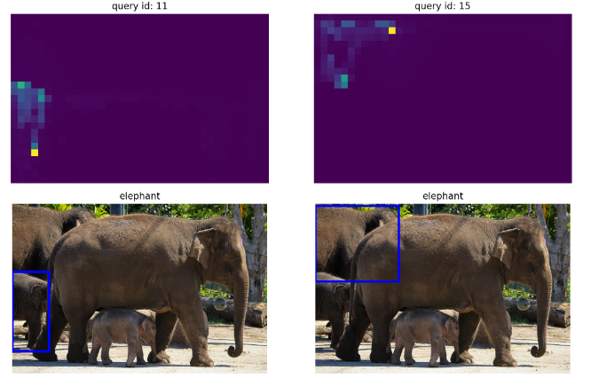
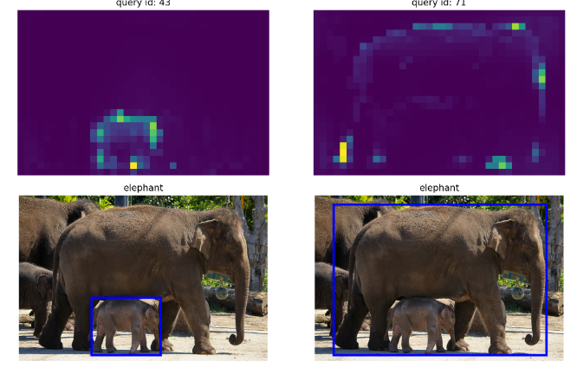
Results
Encoder-Decoder Multihead attention weight visualizer

Slide 12
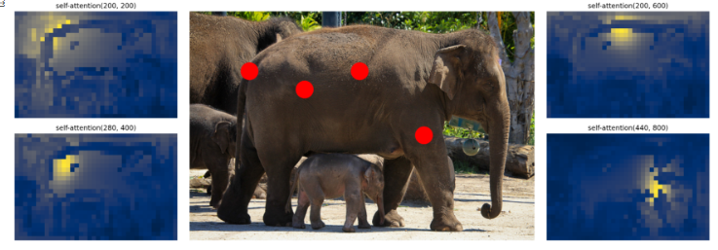
Results
Encoder Self attention
The encoder self attention noting reference point for our model

Slide 13
Results
d Retina.net
vhhbvbjvnjvfnfvbjjvbjvbjvjbPerf
Performance Comaprison of DETR with Classical CNNs
DETR shows great performance according to [5] when compared with classical CNN models such as Faster-RCNN and RetinaNet for object detection.

Slide 14
Conclusion and Outlook
Key Takeaways
Vision for the Future
Call to Action

Slide 15
References
Schott.com
Towardsdatascience.com
labeller.com
Alexey Dosovitskiy, Lucas Beyer, Alexander Kolesnikov, Dirk Weissenborn, Xiaohua Zhai, Thomas Unterthiner, Mostafa Dehghani, Matthias Minderer, Georg Heigold, Sylvain Gelly, et al. An image is worth 16x16 words: Transformers for image recognition at scale. arXiv preprint arXiv:2010.11929, 2021.
Quora
Nicolas Carion, Francisco Massa, Gabriel Synnaeve, Nicolas Usunier, Alexander Kirillov, and Sergey Zagoruyko. End-to-end object detection with transformers. In European conference on computer vision, pages 213–229. Springer,2020.

Slide 16

Question

